Slide 1


Slide 2

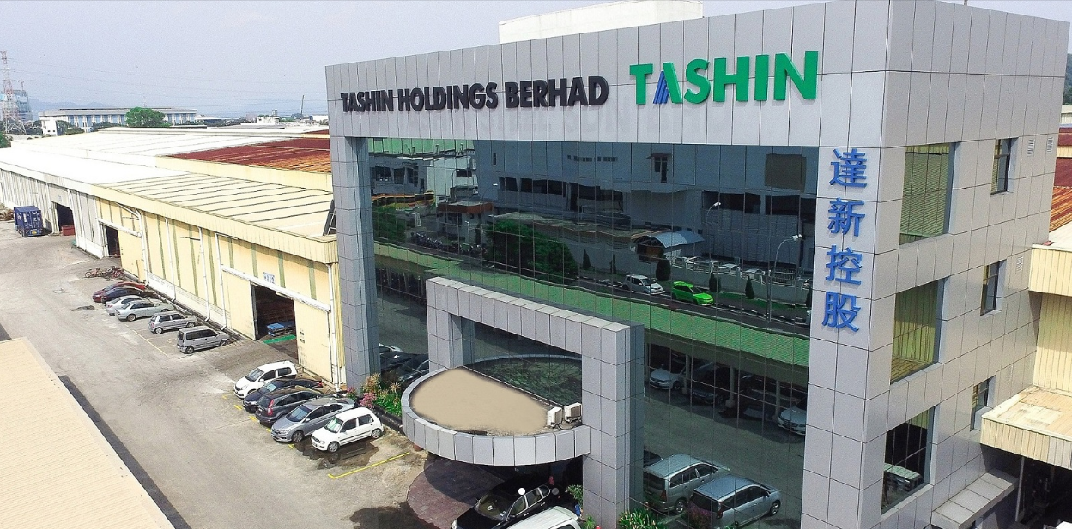
Plot 40, Lorong Perusahaan Maju 7, Kawasan Perusahaan 4, 13600 Prai, Penang, Malaysia.

Slide 3

Tashin Group Corporate Structure
STEEL PROCESSING
STEEL MANUFACTURING/TRADING

Slide 4
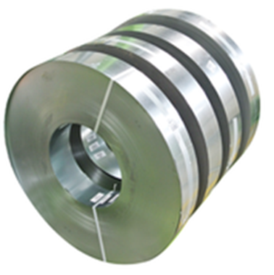
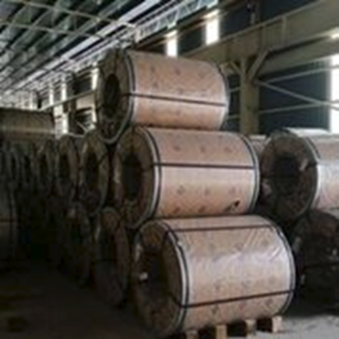
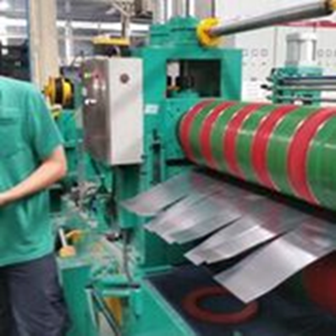


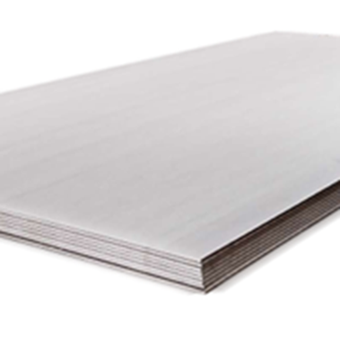

OUR PRODUCT
Steel Processing
Slit Coils
Steel sheets

Slide 5
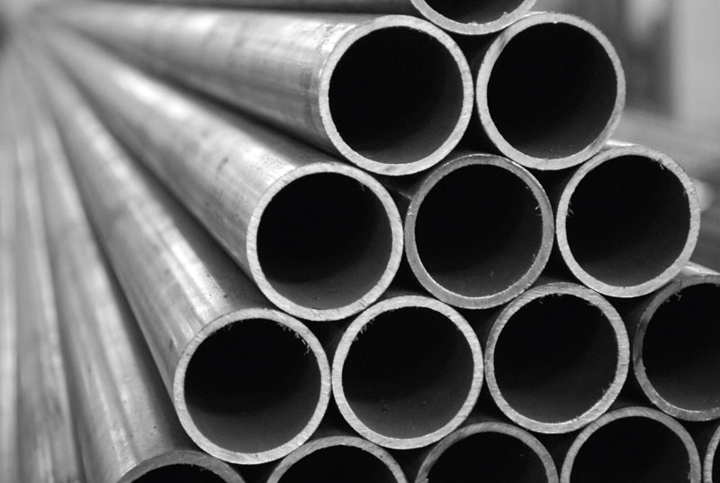
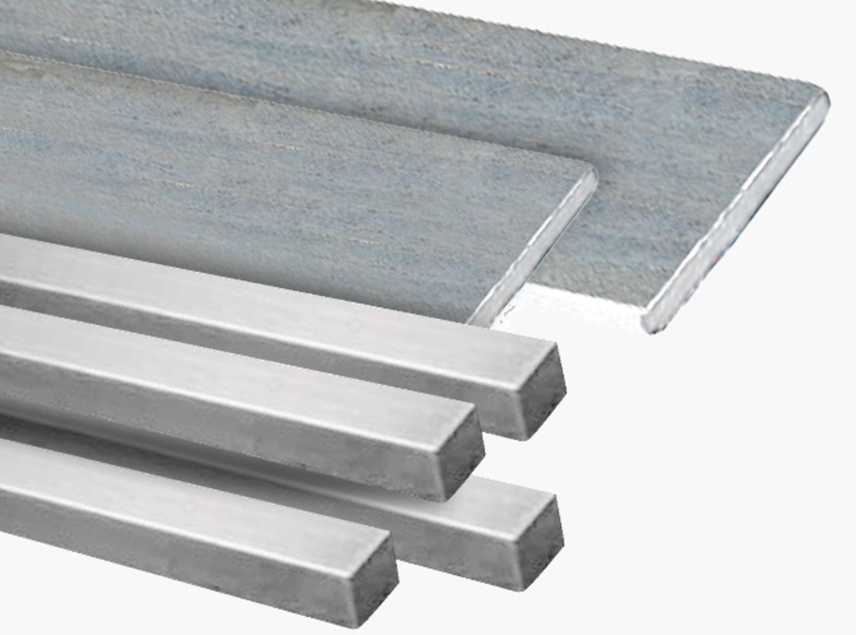
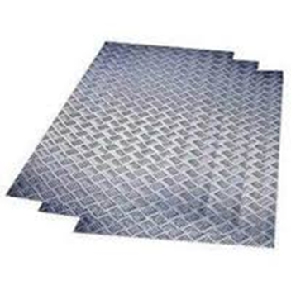
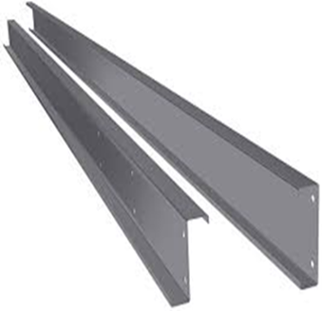
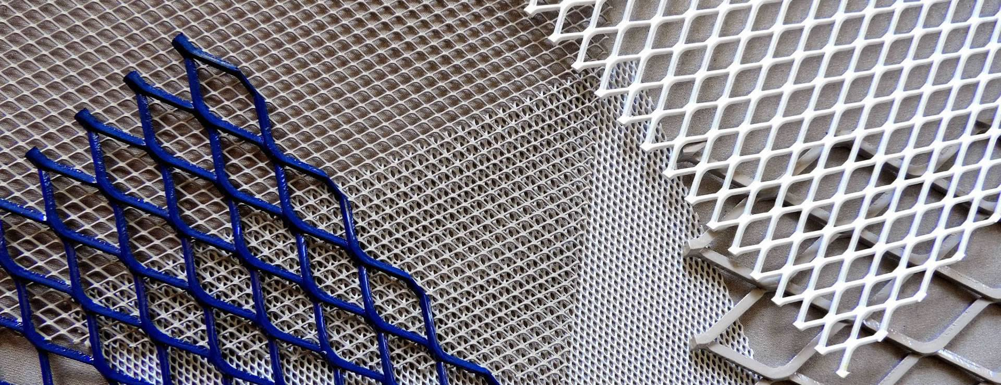
OUR PRODUCT
Steel Pipes
Flat Bar & Square Bar
Checkered Plate
C Pulins
Expanded Metal

Slide 6

Group Financial Highlight

Slide 7
Group Revenue By Year

Slide 8
Profit After Tax By Year

Slide 9
Financial Data – Assets & Earnings

Slide 10
Balance Sheet – Borrowings, Gearing & Cash

Slide 11
Key Financial Data & Ratios
 | As at 31/12/2021 (MYR million) | As at 31/12/2020 (MYR million) | Increased (%) /(Decreased) (%)
Total Assets | 399.16 | 249.71 | 59.85
Net Current Assets | 189.58 | 138.63 | 36.75
Shareholders Funds | 256.21 | 197.36 | 29.82
Borrowings | 54.16 | 25.60 | 111.56
Gearing ratio (times) | 0.21 | 0.13 | 61.54
EPS (sen)* | 17.94 | 2.66 | 15.28 (Sen)

Slide 12
Group Revenue By Quarter – Up to 1Q22
1st Qtr 2022 vs. 4th Qtr 2021 | 8.63%
1st Qtr 2022 vs. 1st Qtr 2021 | 25.54%

Slide 13
Profit After Tax By Quarter – Up to 1Q22
1st Qtr 2022 vs. 4th Qtr 2021 | -24.50%
1st Qtr 2022 vs. 1st Qtr 2021 | -1.56%

Slide 14
Dividend for FY 2021
Proposed Final Dividend of 3.0 sen per share for the Financial Year Ended 31 Dec 2021
Year | No of Shares as at to-date | Final Dividend (sen) | Total Final Dividend (RM'000) | Date of Payment
2021 | 348,991,000 | 3.00 | 10,470 | 15/07/2022
Declared Single-Tier Interim Dividend for the Financial Year Ended 31 Dec 2021
Year | No of Shares as at to-date | Interim Dividend (sen) | Total Interim Dividend (RM'000) | Date of Payment
2021 | 348,991,000 | 2.00 | 6,979 | 16/12/2021

Slide 15
UTILISATION OF IPO PROCEEDS as at 31 Mar 2022
Utilisation of proceeds | Revised Deadline | Proposed utilisation RM’000 | Actual utilisation RM’000 | Percentage utilised (%)
Acquisition of industrial Land and Buildings | 31 July 2022 | 19,565 | 19,565 | 100%
Purchase of machinery and equipment for:
- 3 rotary/auto shearing machines & 1 air compressor | 31 December 2022 | 2,085
- 1 Slitting line | 30 June 2022 | 1,800 | 1,800 | 100%
- 5 auto packing machines | 30 June 2022 | 1,800 | 1,420 | 79%
General working capital | 31 July 2020 | 5,961 | 5,961 | 100%
Estimated listing expenses | 31 August 2019 | 3,200 | 3,200 | 100%
Total |  | 34,411 | 31,946 | 93%
Note: Acquisition of Land & Factory Buildings completed on 13 May 2022

Slide 16
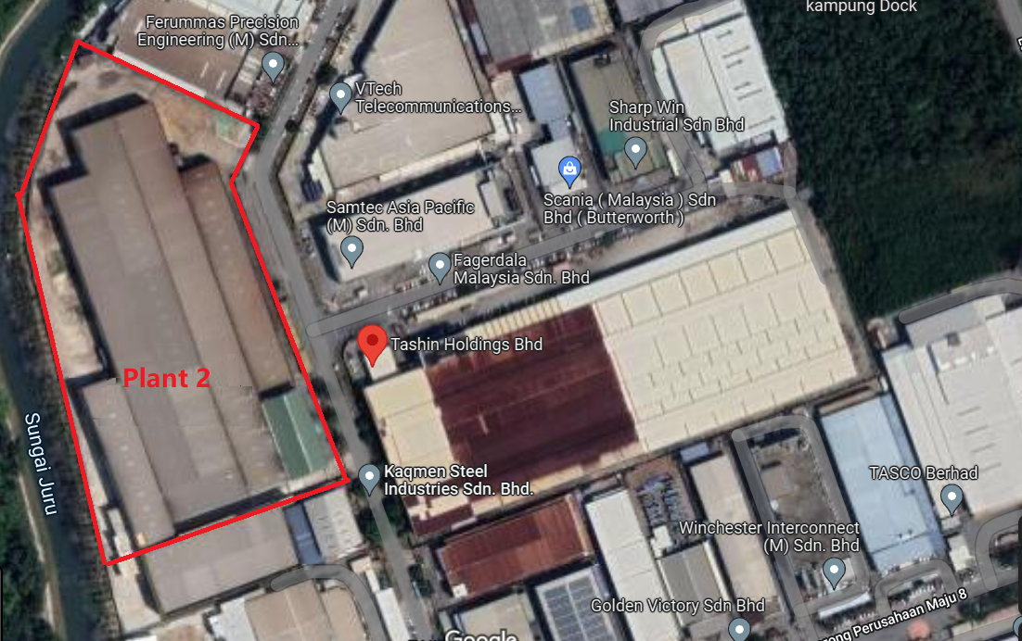
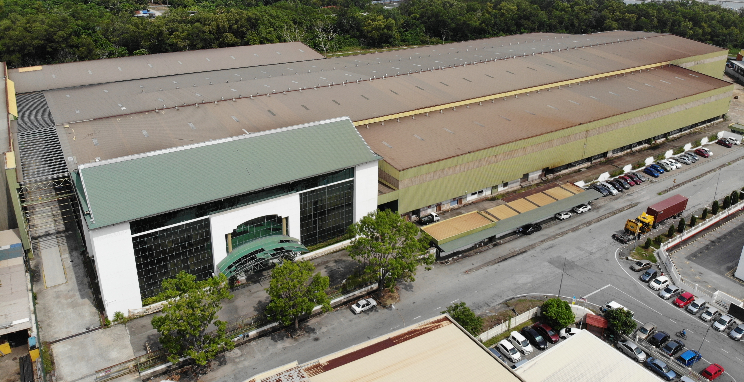
Expansion Plan/Factory Acquisition Completed
New gross floor area: 320,000sq ft

Slide 17
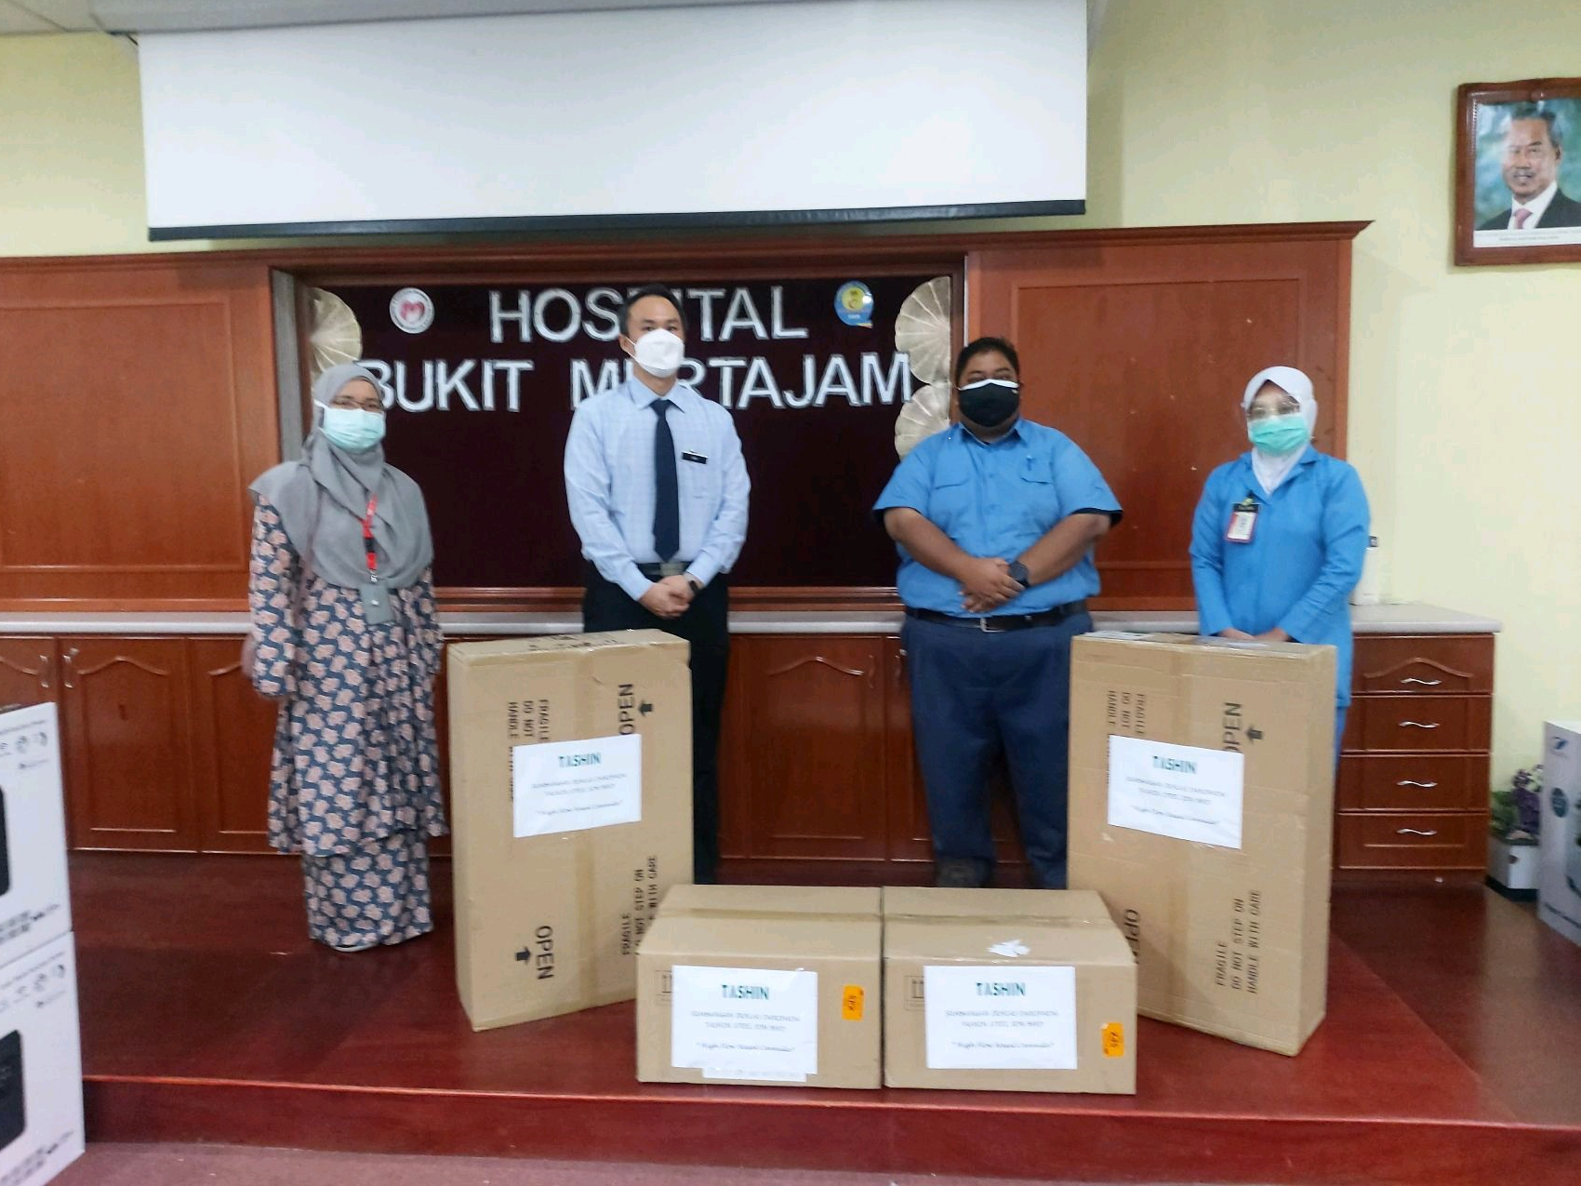
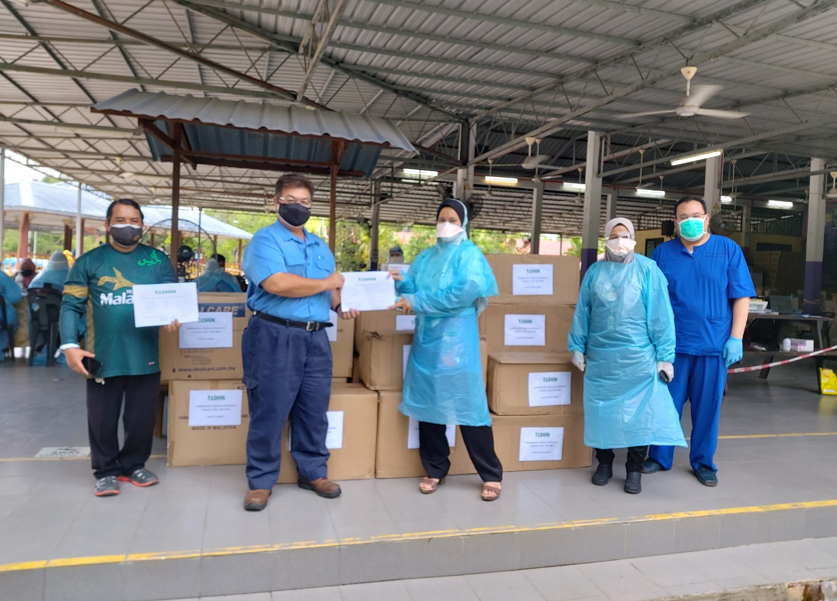
Corporate Social Responsibility
Donation of medical equipment
The Group has initiated a donation of medical equipment and medical supplies for Covid-19 assistance programme to local hospitals in Seberang Perai Tengah, Penang and a cash donations to several schools for their education programme.

Slide 18
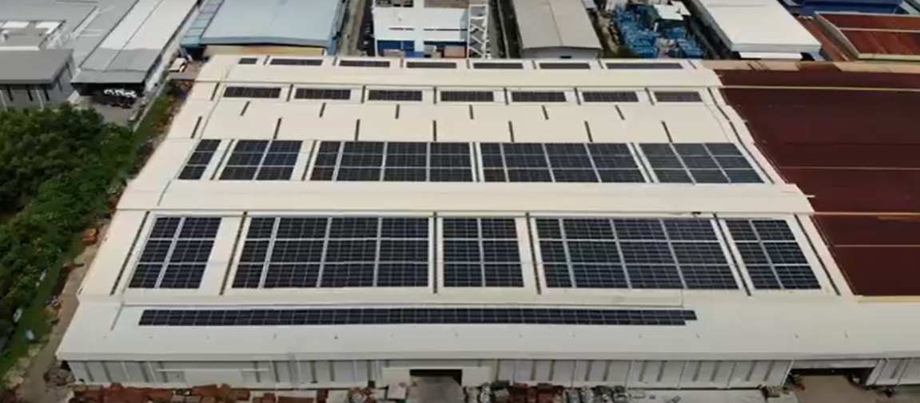
Corporate Social Responsibility
Green Initiatives: Completed 955KW solar panels project to minimise energy consumption

Slide 19


