Slide 1
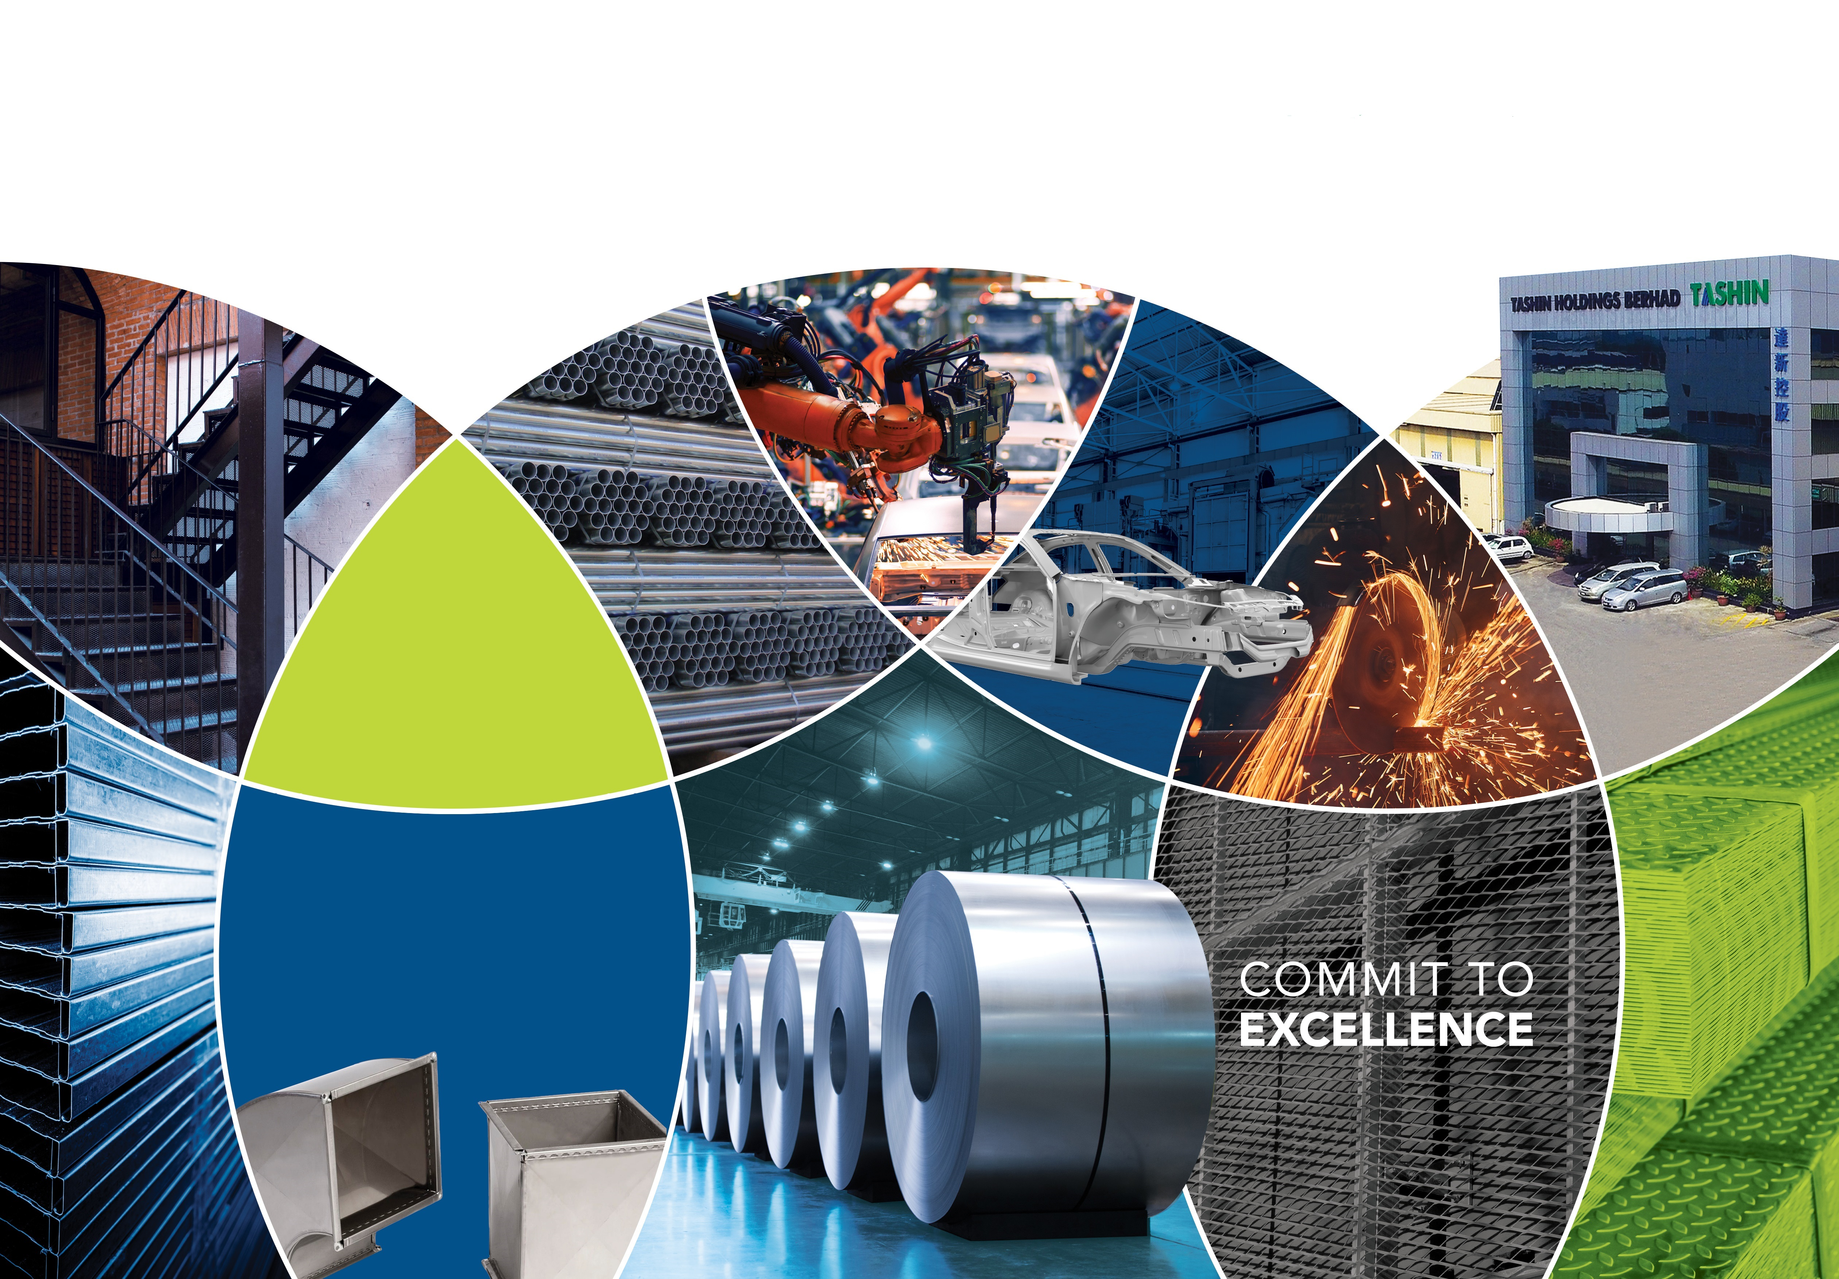

6TH ANNUAL GENERAL MEETING
6th ANNUAL GENERAL MEETING

Slide 2

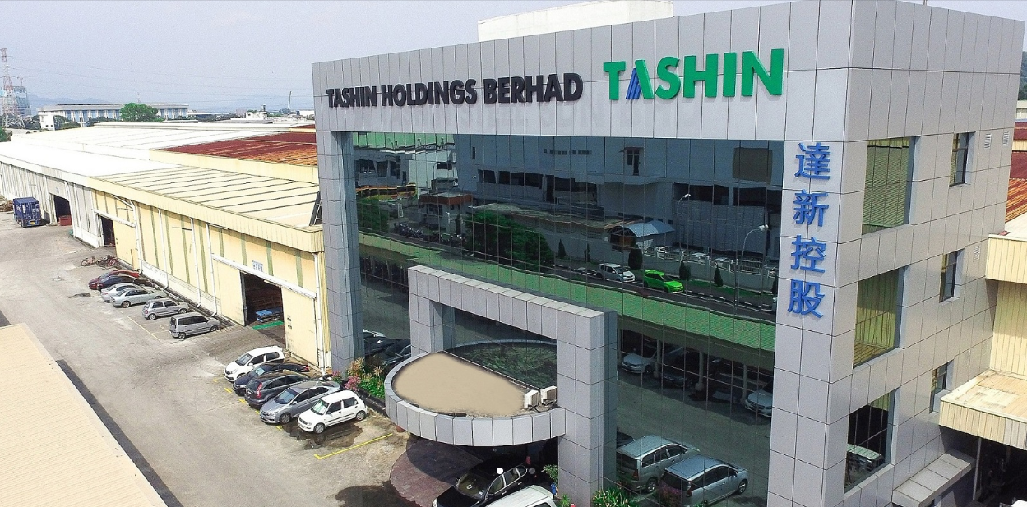
Plot 40, Lorong Perusahaan Maju 7, Kawasan Perusahaan 4, 13600 Prai, Penang, Malaysia.
Tashin Steel Sdn Bhd

Slide 3
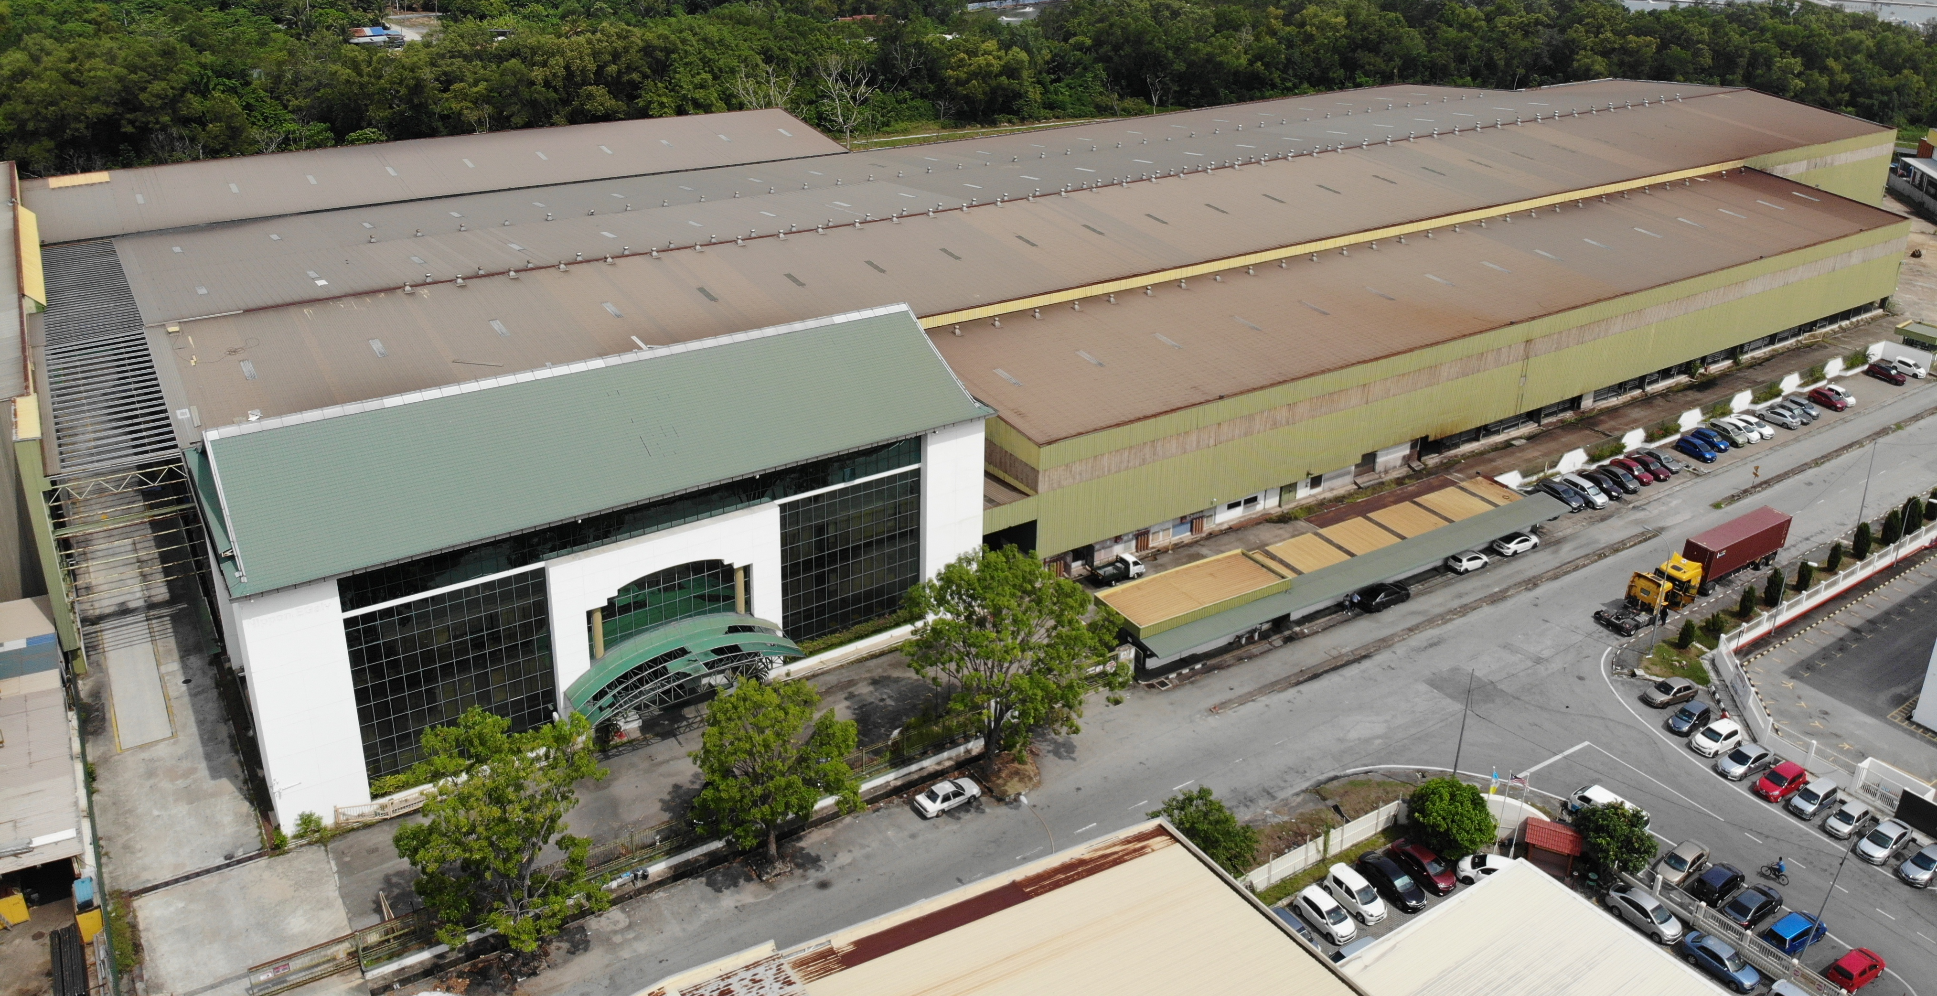
No. 1617,Lorong Perusahaan Maju 6, Kawasan Perusahaan 4, 13600 Prai, Penang, Malaysia.
Tashin Hardware Sdn Bhd

Slide 4
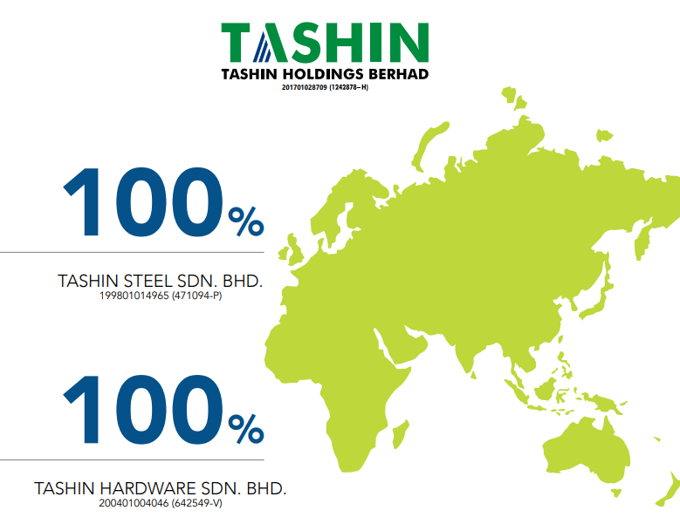
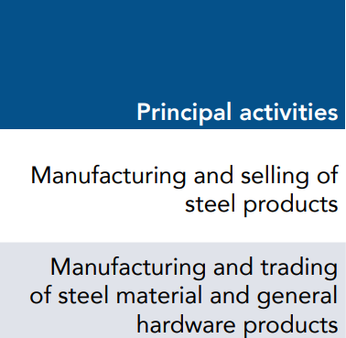
Tashin Group Corporate Structure

Slide 5
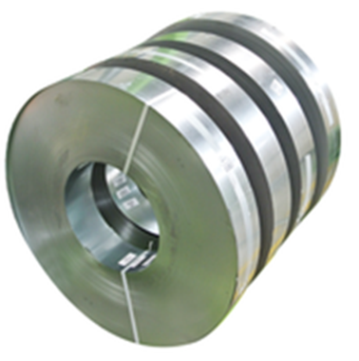
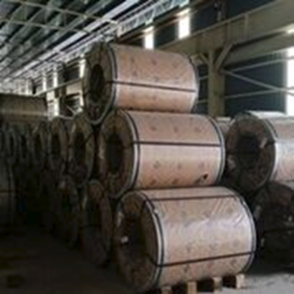
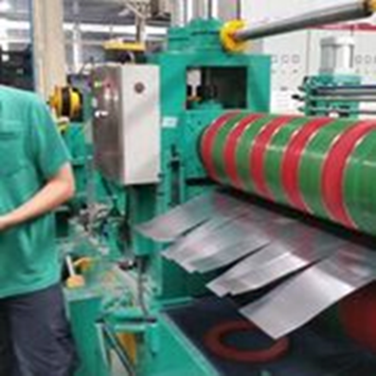


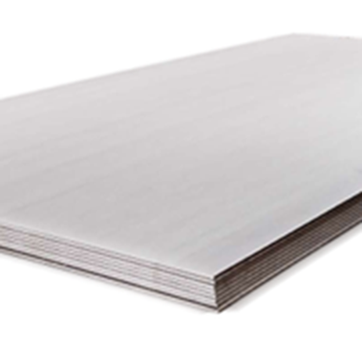

OUR PRODUCT
Steel Processing
Slit Coils
Steel sheets

Slide 6
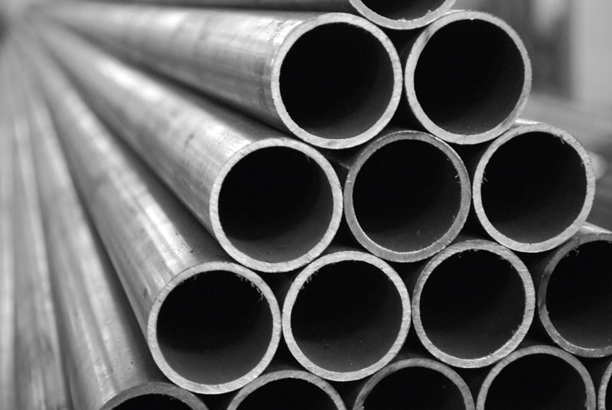
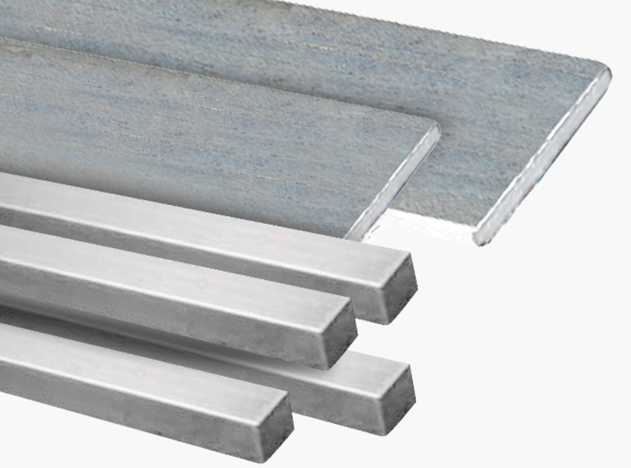
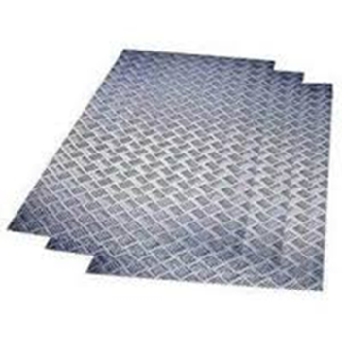
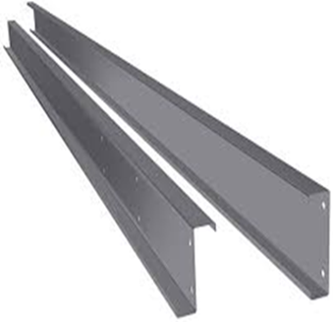
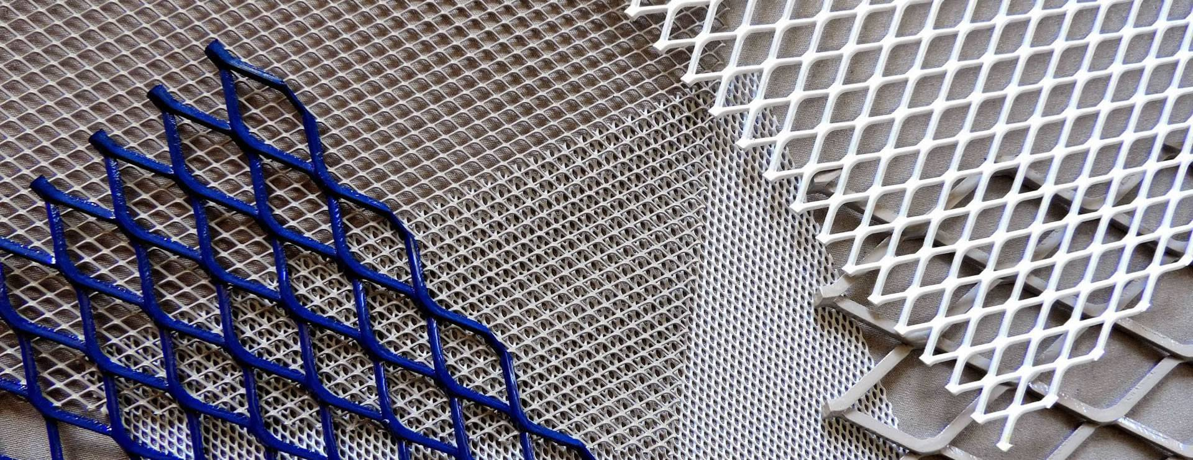
OUR PRODUCT
Steel Pipes
Flat Bar & Square Bar
Checkered Plate
C Pulins
Expanded Metal

Slide 7

Group Financial Highlight

Slide 8
Group Revenue By Year

Slide 9
Profit After Tax By Year

Slide 10
Financial Data – Assets & Earnings

Slide 11
Balance Sheet – Borrowings, Gearing & Cash

Slide 12
Key Financial Data & Ratios
 | As at 31/12/2022 (MYR million) | As at 31/12/2021 (MYR million) | Increased (%) /(Decreased) (%)
Total Assets | 377.56 | 399.16 | (5.41)
Net Current Assets | 157.70 | 189.58 | (16.82)
Shareholder’s Funds | 258.86 | 256.21 | 1.37
Borrowings | 67.04 | 54.16 | 23.78
Gearing ratio (times) | 0.26 | 0.21 | 23.81
EPS (sen)* | 3.76 | 17.94 | (-14.18 Sen)

Slide 13
Group Revenue By Quarter – Up to 1Q23
1st Qtr 2023 vs. 4th Qtr 2022 | -6.63%
1st Qtr 2023 vs. 1st Qtr 2022 | -22.79%

Slide 14
Profit After Tax By Quarter – Up to 1Q23
1st Qtr 2023 vs. 4th Qtr 2022 | 188.88%
1st Qtr 2023 vs. 1st Qtr 2022 | -82.15%

Slide 15
Dividend for FY 2022
Proposed Final Dividend of 2.0 sen per share for the Financial Year Ended 31 Dec 2022
Year | No of Shares as at to-date | Final Dividend (sen) | Total Dividend (RM'000) | Date of Payment
2022 | 348,991,000 | 2.00 | 6,979 | 14/07/2023
Declared Total Single-Tier Dividend for the Financial Year Ended 31 Dec 2021
Year | No of Shares as at to-date | Interim & Final Dividend (sen) | Total Dividend (RM'000) | Date of Payment
2021 | 348,991,000 | 5.00 | 17,450 | 08/06/2022 & 16/12/2021

Slide 16
UTILISATION OF IPO PROCEEDS as at 31 Dec 2022
Utilisation of proceeds | Revised Deadline | Proposed utilisation RM’000 | Actual utilisation RM’000 | Percentage utilised (%)
Acquisition of industrial Land and Buildings | 31 July 2022 | 19,565 | 19,565 | 100%
Purchase of machinery and equipment for:
- 1 air compressor | 31 December 2022 | 108 | 108 | 100%
- 1 Slitting line | 30 June 2022 | 1,800 | 1,800 | 100%
- 5 auto packing machines | 30 June 2022 | 1,800 | 1,800 | 100%
General working capital | 31 December 2022 | 7,938 | 7,938 | 100%
Estimated listing expenses | 31 August 2019 | 3,200 | 3,200 | 100%
Total |  | 34,411 | 34,411 | 100%
Note: THB has fully utilised the IPO proceeds.

Slide 17
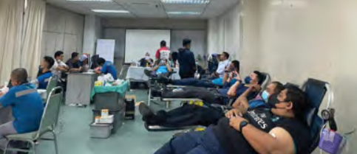
Corporate Social Responsibility
Blood donation campaign (December 2022)
Blood donation campaign at our Prai office, in collaboration with Jabatan Pathalogy Hospital Seberang Jaya.

Slide 18
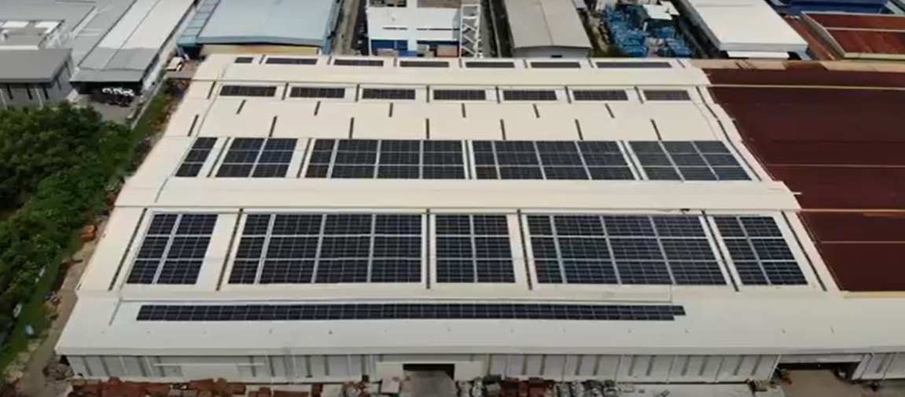
Corporate Social Responsibility
Green Initiatives: Completed 955KW solar panels project to minimise energy consumption

Slide 19


