Slide 1


7TH ANNUAL GENERAL MEETING
6June 2024

Slide 2


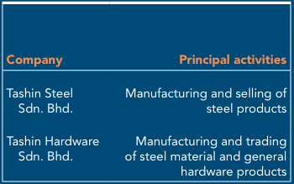
Tashin Group Corporate Structure

Slide 3
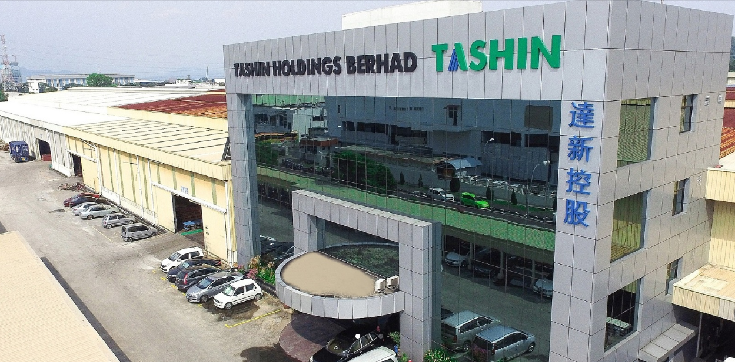
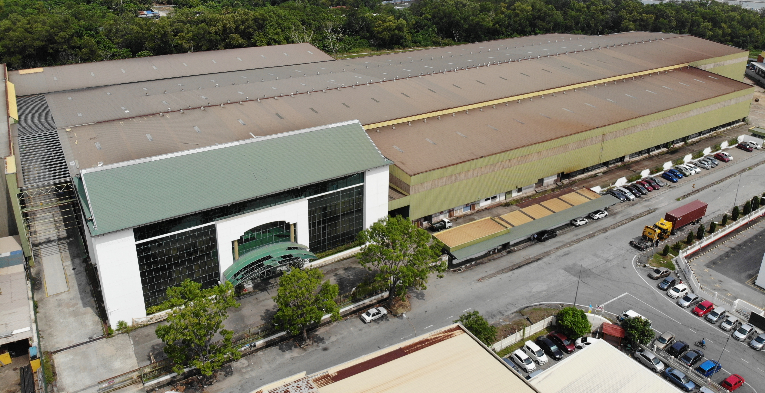
Plot 40, Lorong Perusahaan Maju 7, Kawasan Perusahaan 4, 13600 Prai, Penang, Malaysia.
No. 1617,Lorong Perusahaan Maju 6, Kawasan Perusahaan 4, 13600 Prai, Penang, Malaysia.
Tashin Steel Sdn Bhd
Tashin Hardware Sdn Bhd

Slide 4
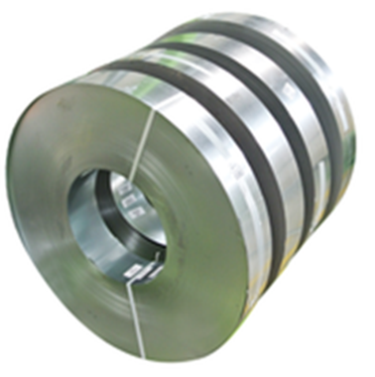
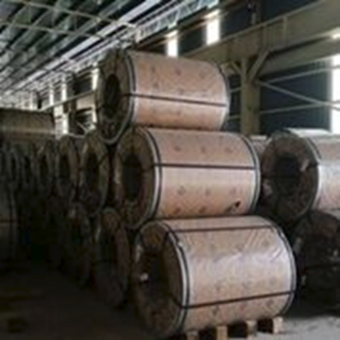
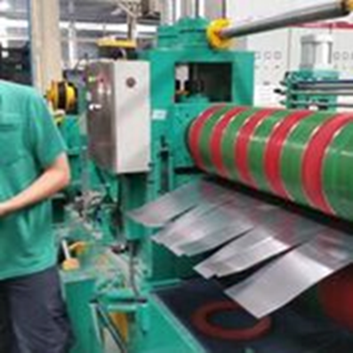




OUR PRODUCT
Steel Processing
Slit Coils
Steel sheets

Slide 5


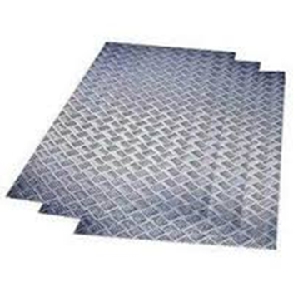
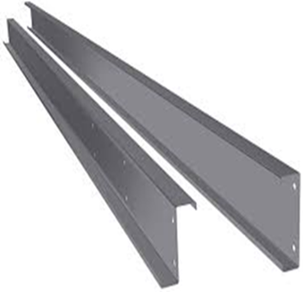
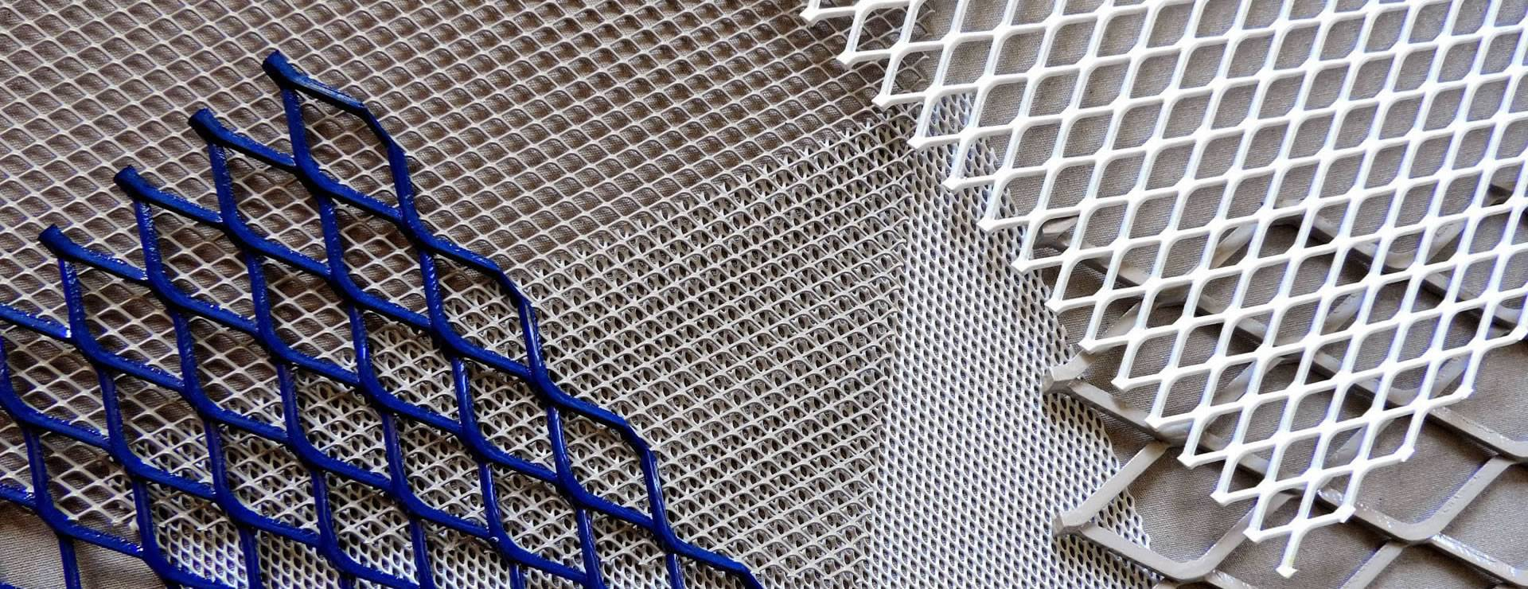
OUR PRODUCT
Steel Pipes
Flat Bar & Square Bar
Checkered Plate
C Pulins
Expanded Metal

Slide 6

Group Financial Highlight

Slide 7
Group Revenue By Year

Slide 8
Profit After Tax By Year

Slide 9
Key Financial Data & Ratios
 | As at 31/12/2023 (MYR million) | As at 31/12/2022 (MYR million) | Increased (%) /(Decreased) (%)
Total Assets | 337.31 | 377.56 | (10.66)
Net Current Assets | 157.22 | 157.70 | (0.30)
Shareholder’s Funds | 258.04 | 258.86 | (0.32)
Borrowings | 41.33 | 67.04 | (38.35)
Gearing ratio (times) | 0.16 | 0.26 | (38.46)
EPS (sen)* | 1.77 | 3.76 | (-1.99 Sen)

Slide 10
Group Revenue By Quarter – Up to 1Q24
1st Qtr 2024 vs. 4th Qtr 2023 | -7.33%
1st Qtr 2024 vs. 1st Qtr 2023 | -4.93%

Slide 11
Profit After Tax By Quarter – Up to 1Q24
1st Qtr 2024 vs. 4th Qtr 2023 | 50.14%
1st Qtr 2024 vs. 1st Qtr 2023 | -26.05%

Slide 12
Dividend for FY 2023
Proposed Final Dividend of 1.5 sen per share for the Financial Year Ended 31 Dec 2023
Year | No of Shares as at to-date | Final Dividend (sen) | Total Dividend (RM'000) | Date of Payment
2023 | 348,991,000 | 1.50 | 5,235 | 14/07/2024
Declared Total Single-Tier Dividend for the Financial Year Ended 31 Dec 2022
Year | No of Shares as at to-date | Interim & Final Dividend (sen) | Total Dividend (RM'000) | Date of Payment
2022 | 348,991,000 | 2.00 | 6,980 | 14/07/2023

Slide 13
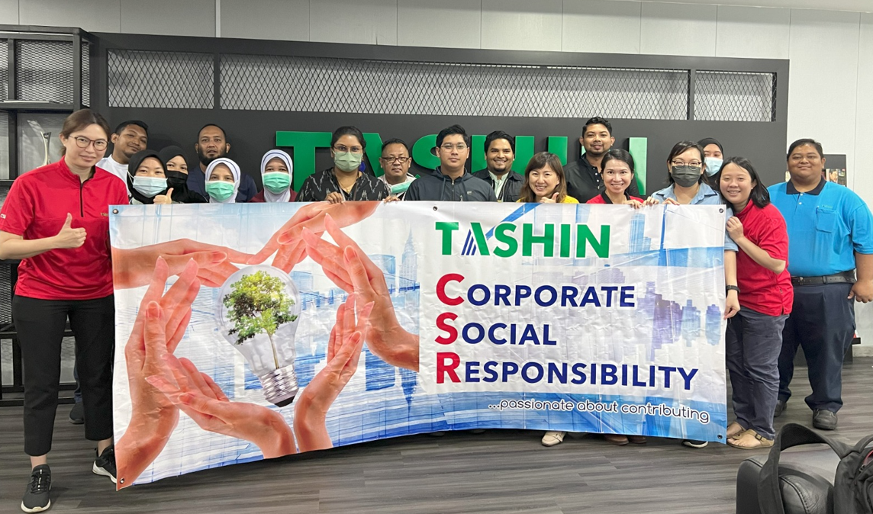
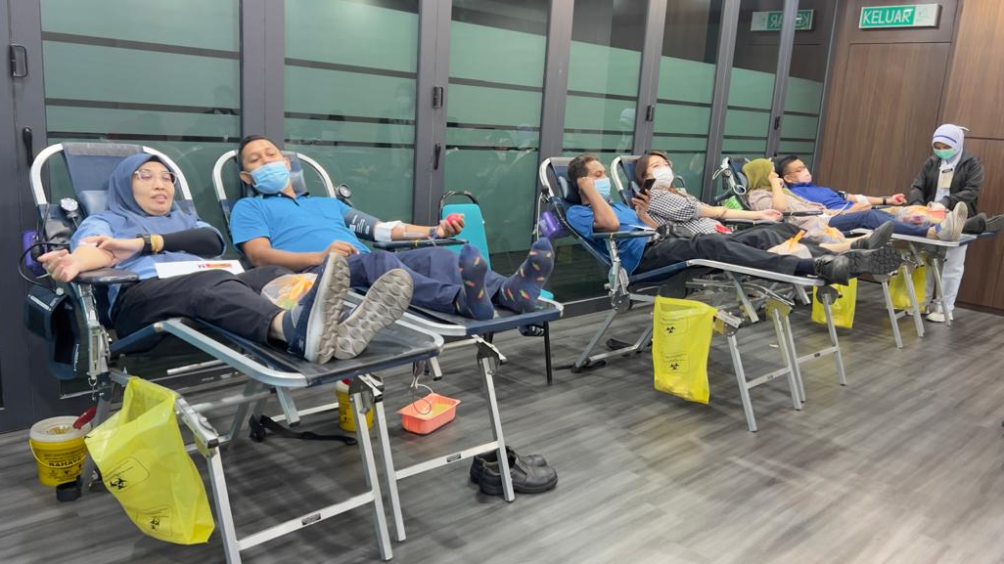
Corporate Social Responsibility
Blood donation campaign (November 2023)
Blood donation campaign at our Prai office, in collaboration with Jabatan Pathalogy Hospital Seberang Jaya.

Slide 14
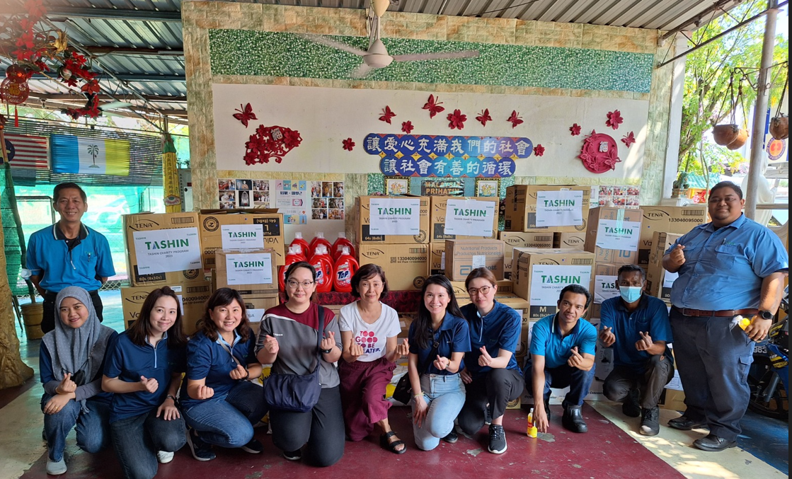
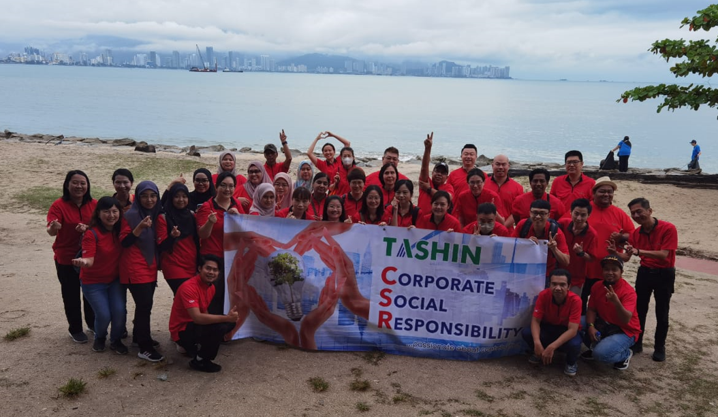
Corporate Social Responsibility
Donation to the elderly residents of Pusat Penjagaan Ceria
Beach cleaning event at Bagan Ajam Rest Area

Slide 15

End of presentation

