Slide 1


8TH ANNUAL GENERAL MEETING
5 June 2025

Slide 2

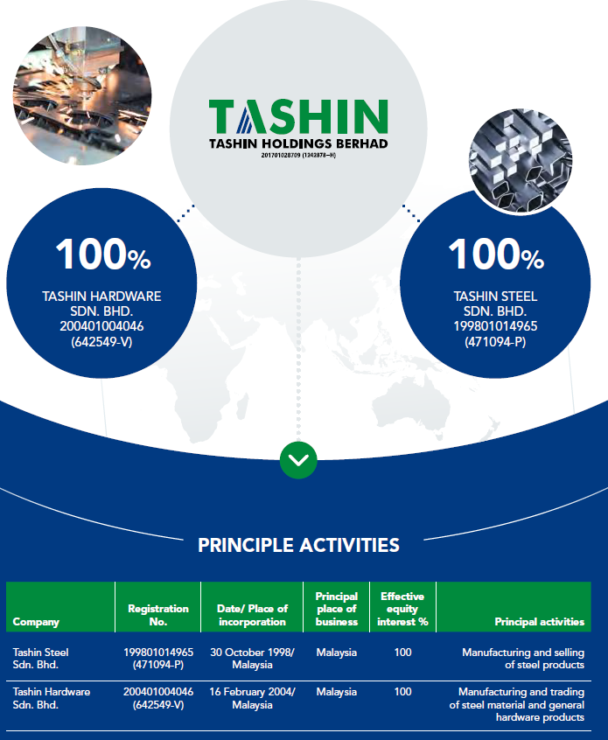
Tashin Group Corporate Structure

Slide 3
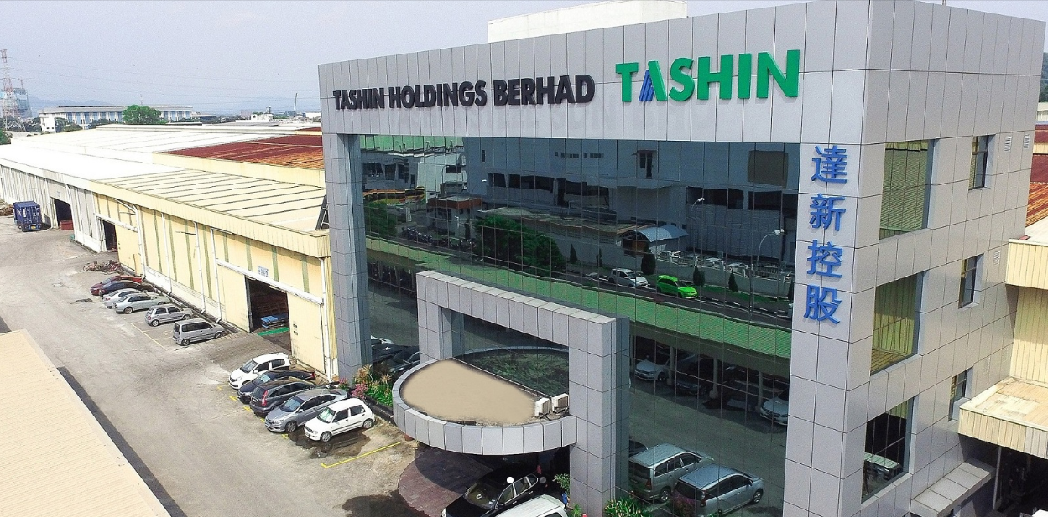
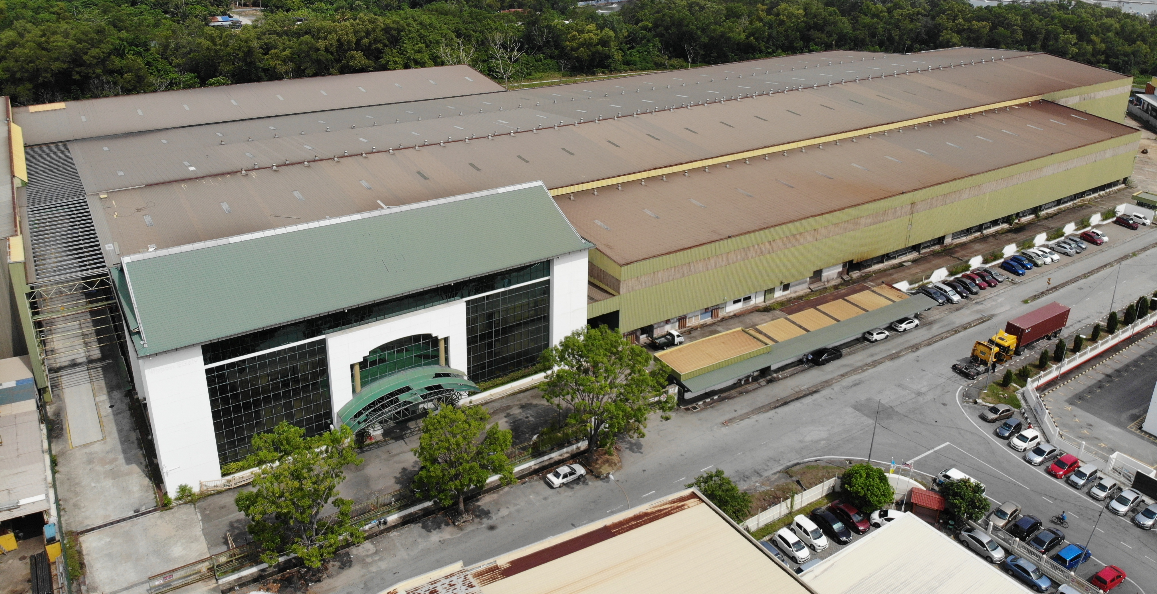
Plot 40, Lorong Perusahaan Maju 7, Kawasan Perusahaan 4, 13600 Prai, Penang, Malaysia.
No. 1617,Lorong Perusahaan Maju 6, Kawasan Perusahaan 4, 13600 Prai, Penang, Malaysia.
Tashin Steel Sdn Bhd
Tashin Hardware Sdn Bhd

Slide 4
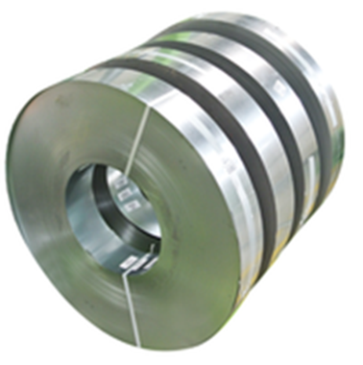
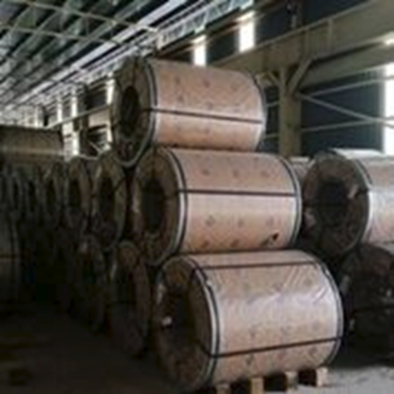
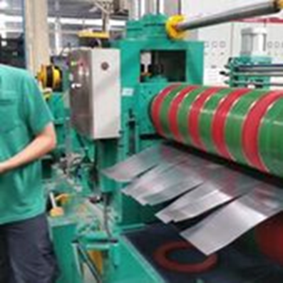


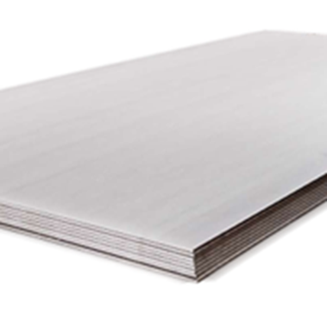

OUR PRODUCT
Steel Processing
Slit Coils
Steel sheets

Slide 5
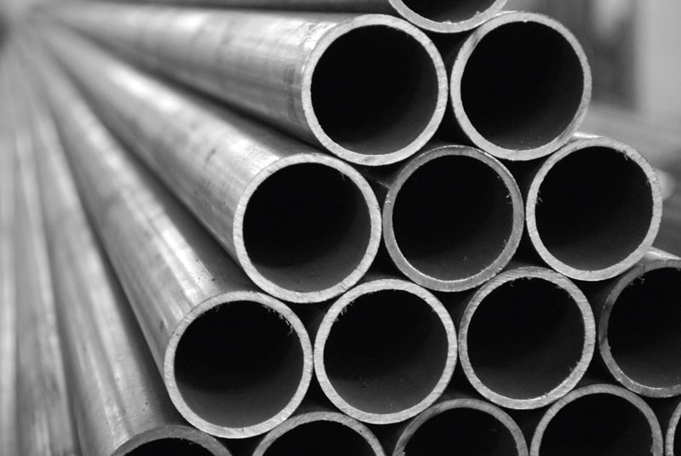
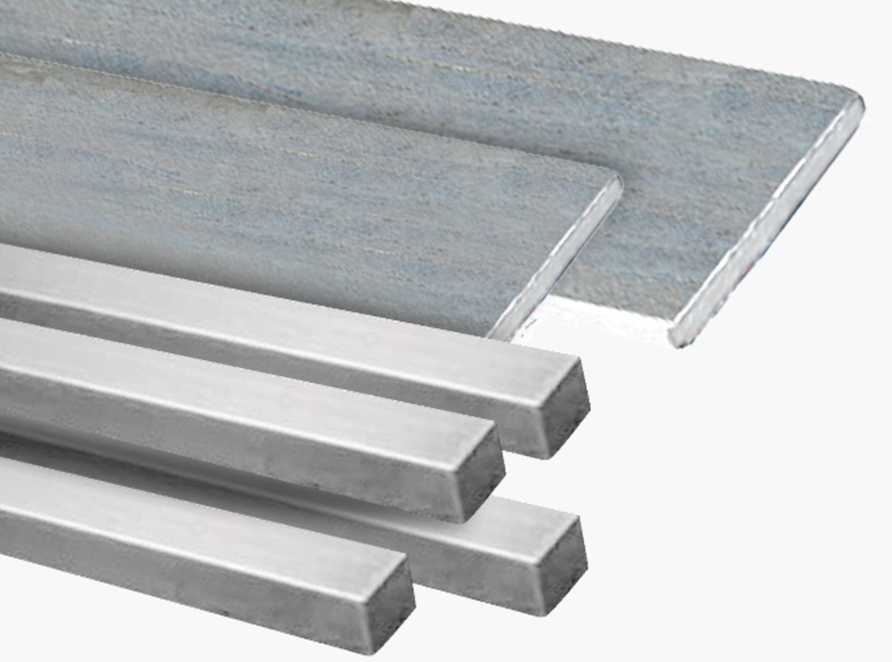
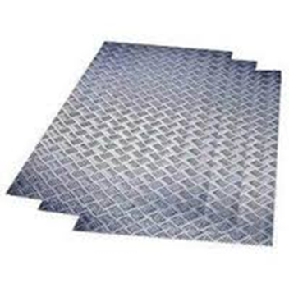
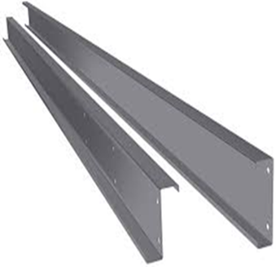
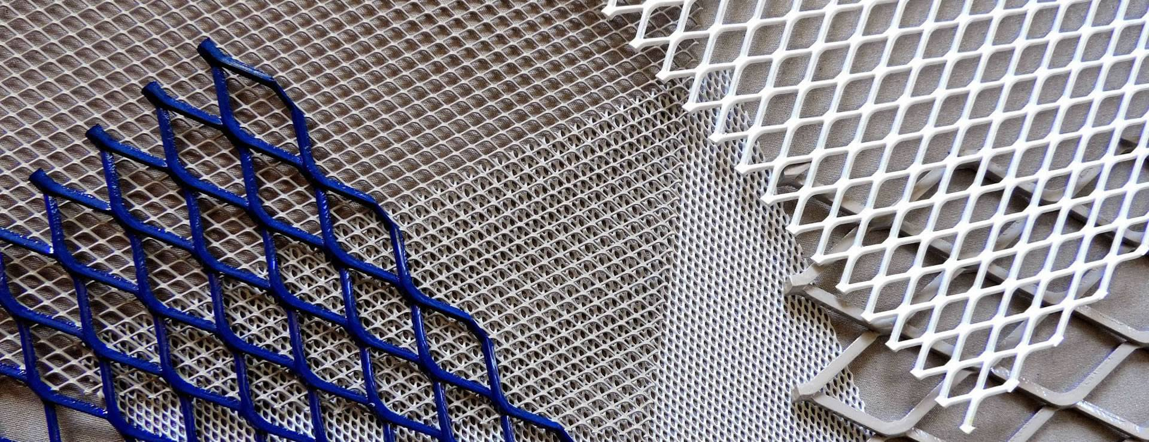
OUR PRODUCT
Steel Pipes
Flat Bar & Square Bar
Checkered Plate
C Pulins
Expanded Metal

Slide 6

Group Financial Highlight

Slide 7
Group Revenue By Year

Slide 8
Profit After Tax By Year

Slide 9
Key Financial Data & Ratios
 | As at 31/12/2024 (MYR million) | As at 31/12/2023 (MYR million) | Increased (%) /(Decreased) (%)
Total Assets | 382.37 | 337.31 | 13.36
Net Current Assets | 140.41 | 157.22 | (10.69)
Shareholder’s Funds | 269.54 | 258.04 | 4.46
Borrowings | 70.22 | 41.33 | 69.90
Gearing ratio (times) | 0.26 | 0.16 | 62.50
EPS (sen)* | (0.31) | 1.77 | (2.08 Sen)

Slide 10
Group Revenue By Quarter – Up to 1Q25
1st Qtr 2025 vs. 4th Qtr 2024 | -5.33%
1st Qtr 2025 vs. 1st Qtr 2024 | -1.70%

Slide 11
Profit After Tax By Quarter – Up to 1Q25
1st Qtr 2025 vs. 4th Qtr 2024 | 110.99%
1st Qtr 2025 vs. 1st Qtr 2024 | -84.91%

Slide 12
Dividend for FY 2024
The Directors do not recommend the payment of any other dividend in respect of the current financial year.
Declared Total Single-Tier Dividend for the Financial Year Ended 31 Dec 2023
Year | No of Shares as at to-date | Interim & Final Dividend (sen) | Total Dividend (RM'000) | Date of Payment
2023 | 348,991,000 | 1.50 | 5,235 | 12/07/2024

Slide 13
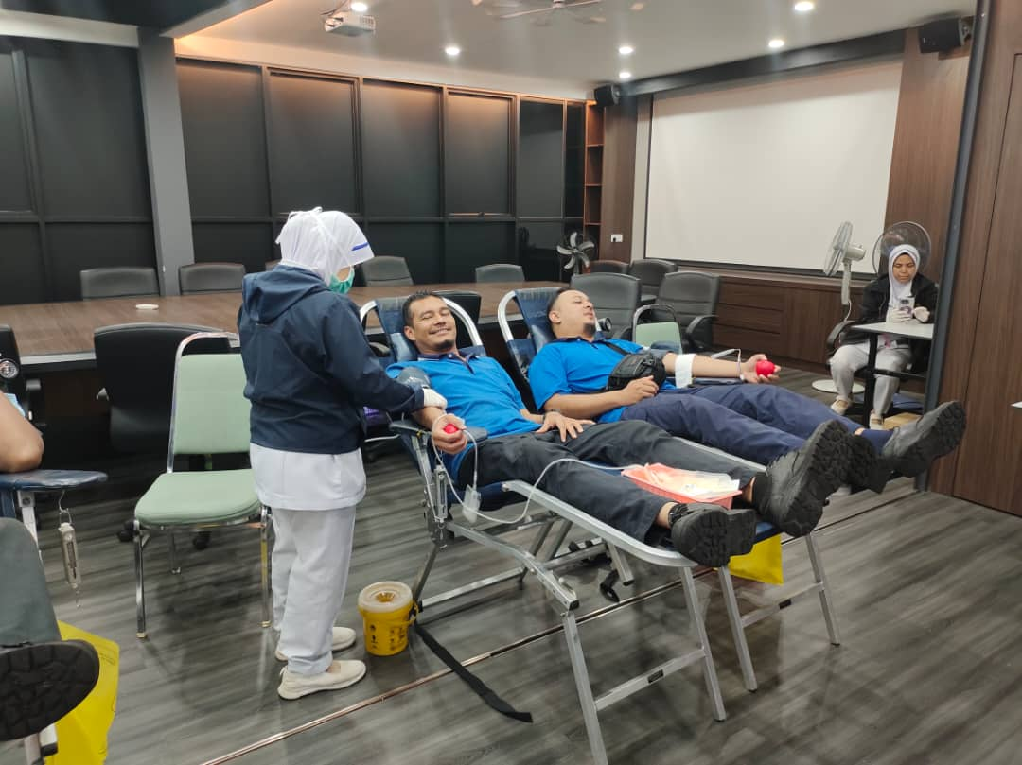
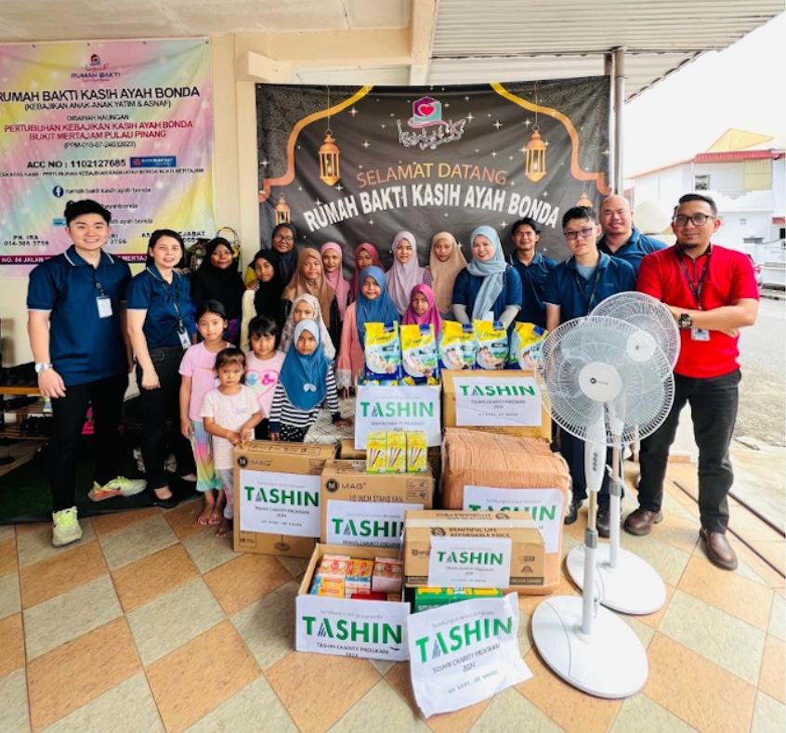
Corporate Social Responsibility
Blood donation campaign (October 2024)
Donation to the Kebajikan Anak-Anak Yatim & Asnaf (Rumah Bakti Kasih Ayah Bonda)
Blood donation campaign at our Prai office, in collaboration with Jabatan Pathalogy Hospital Seberang Jaya.

Slide 14

End of presentation

